Slide 1
Phase 2 & Virtual Learning
for AAHS Students
Information
Notes:
Christine

Slide 2
What’s the Same?
What’s New?
Phase 2 Learning Will Begin Monday, April 12
Students will access their material on Google Classroom, as they have done with previous quarters.
Teachers will be available for students daily through office hours
Student-teacher meetings will continue via zoom
Students have the option of meeting IN-PERSON with teachers by appointment, but only for a scheduled amount of time
Notes:
Jeff

Slide 3
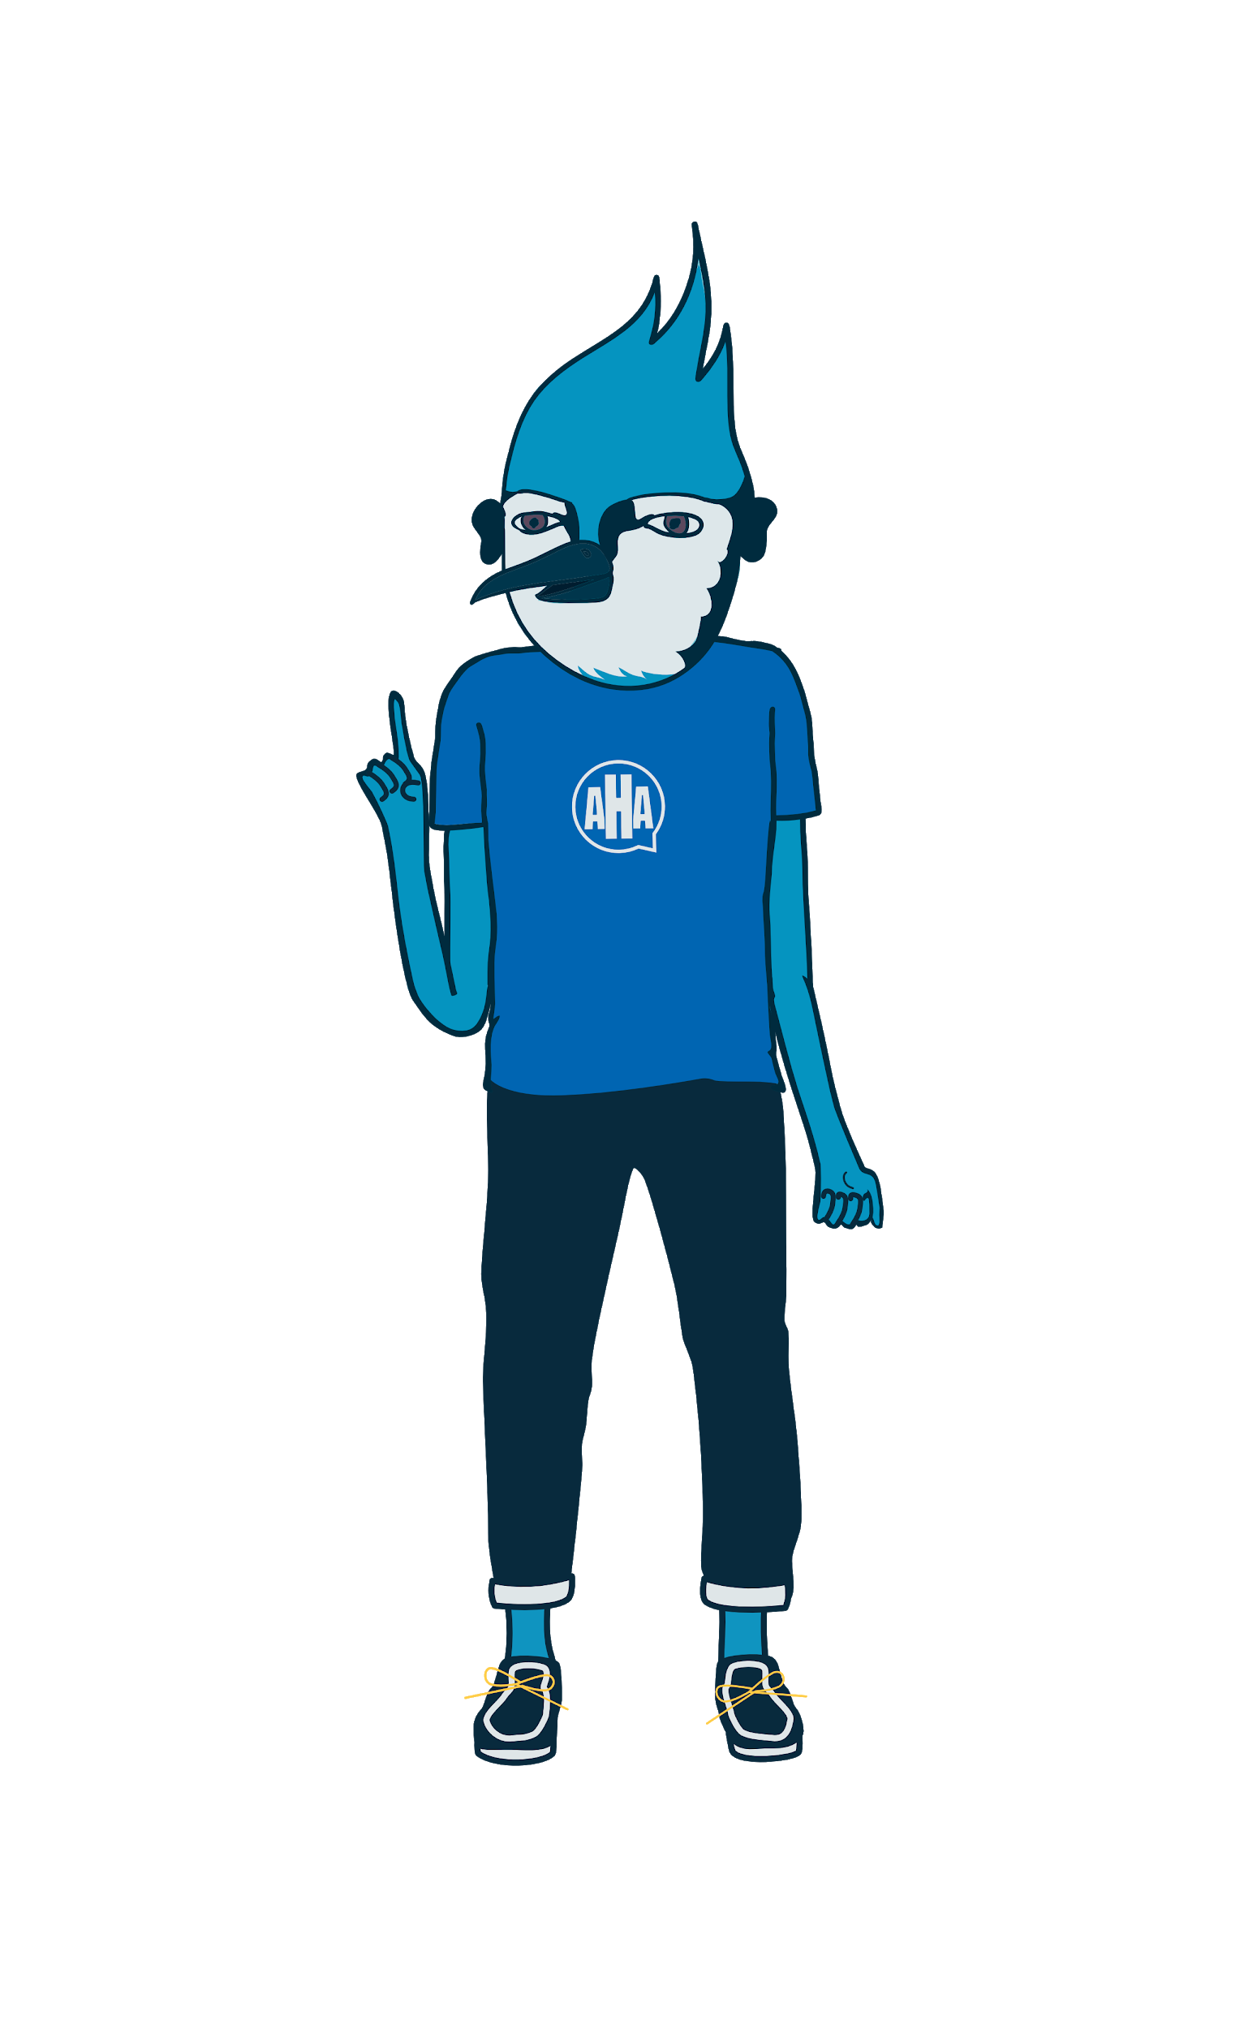
How will In-Person Appointments Work?
Students can be at school for no more than 2 hours, once per week by appointments. (Monday, Tuesday, Thursday, Friday)
Appointments will be scheduled online or through your advisor on a weekly basis
Notes:
Christine

Slide 4
Do I HAVE to come in for In-Person Appointments?
No, you don’t HAVE to make appointments. People have different levels of comfort with leaving the house during COVID and that’s ok. But it would be great to see you! Plus, in-person meetings can be very helpful when you’re struggling with content.
Notes:
Gene

Slide 5
What will the week look like?
Your school week will look the same. The only difference is that you will be able to meet in-person with a staff member for up to 2 hours each week.
Wednesdays will continue to be AHA Days and the building will be closed to students.
Notes:
Gene

Slide 6
Health and Safety Measures
Social Distancing: A minimum of 3 feet will be required at all times. Only 4 students allowed per classroom.
Increased Daily Disinfecting: Custodial staff prioritize high-touch areas such as door handles, switches, hand railings, desks and bathrooms. Bleach wipes and disinfectant sprays are available for staff use on-site.
Face Coverings: Required for all students and staff unless medically exempt (please send proof to covid@academicarts.org). Extras are available at school if needed. Face coverings MUST cover both mouth and nose at all times.
Daily Health Screening: Families should check for symptoms every morning before sending your student to school. If they are sick, they must stay home and be reported absent.

Slide 7
COVID-19 Reporting
COVID-19 Reporting
If your student is sick or has had close contact with someone who tested positive for COVID-19, do not send them to school and submit a report to the COVID-19 Reporting System the same day for next steps
Students who become sick during the school day will be isolated (under supervision) until they can be picked up. Prompt pickup is essential.
When there is a case at school, the COVID-19 Communications Protocol will be followed to determine notifications needed
Students who are quarantined will resume distance learning until they are cleared to return
AAHS Covid Reporting System

Slide 8
Questions?
Contact your Advisor OR you can email covid@academicarts.org
Notes:
Christine

